Slide 1
Unit 6 Trade

Slide 2
Clear Target
I will be able to identify benefits countries receive from trade.
I will be able to explain the difference between absolute and comparative advantage.

Slide 3
Why Do Countries Trade?
Improve utility
Work to their advantage
Wield political power

Slide 4
Improve Utility
Utility | No Trade | Local Trade | Global trade
1
2
3
4
5
6
7
8
9
10
1 = no satisfaction 10 = highest satisfaction

Slide 5
Improve Utility
Gain new resources
Switzerland is land locked and must trade for sea food.
Preserve resources
The U.S. has large oil reserves but still buys much of its oil from the Middle East.

Slide 6
Work to their advantage
Absolute advantage
A country’s ability to produce more of a good or service using the same resources as another country.
Comparative advantage
A country’s ability to produce more of a good or service with a lower opportunity cost than another country.

Slide 7
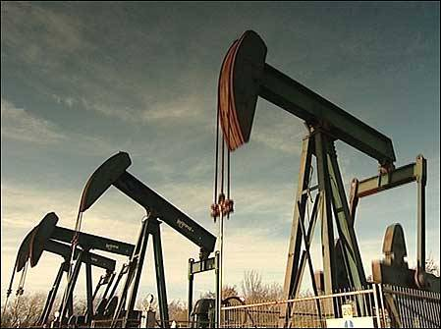
Specialization
Focused production of the goods and services people and countries have a comparative advantage in producing.
Vs.

Slide 8
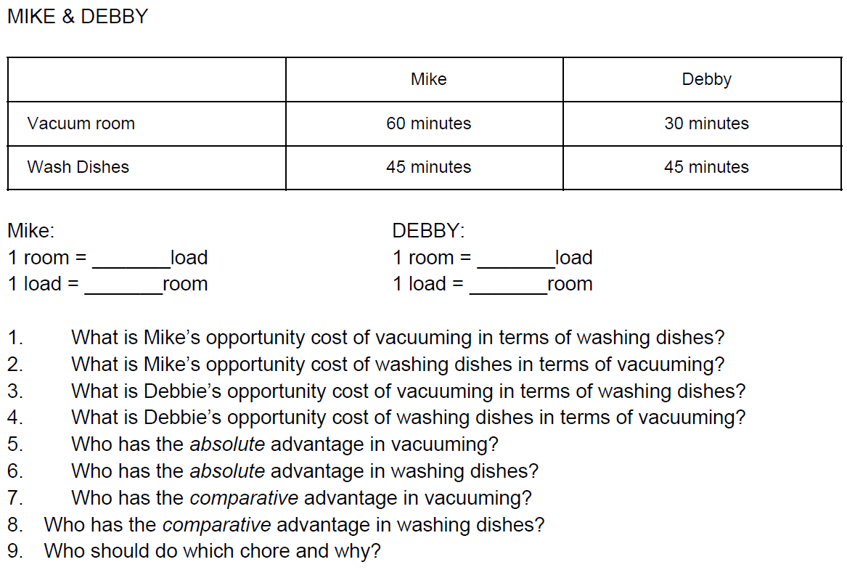

Slide 9
Political Power
Countries that depend on each other for trade are less likely to fight each other.
Trade balance
Positive trade balance = exporting more than you import.
Other countries depend on our resources.
Negative trade balance = importing more than you export.
Other countries depend on our money.

Slide 10
Political Power
Trade restrictions
Embargo / Sanctions – a complete ban on the import or export of particular goods going to or coming from a specific country.
Current countries under U.S. embargo: Syria, Cuba, North Korea, Russia
Tariffs – a tax on imported goods.
Revenue tariff – a tax on imports to raise money for the government.
Protectionist tariff – a tax on imports to make foreign goods more expensive than domestic goods.
Import quotas – a restriction on the number of a good that can be brought into a country.

Slide 11
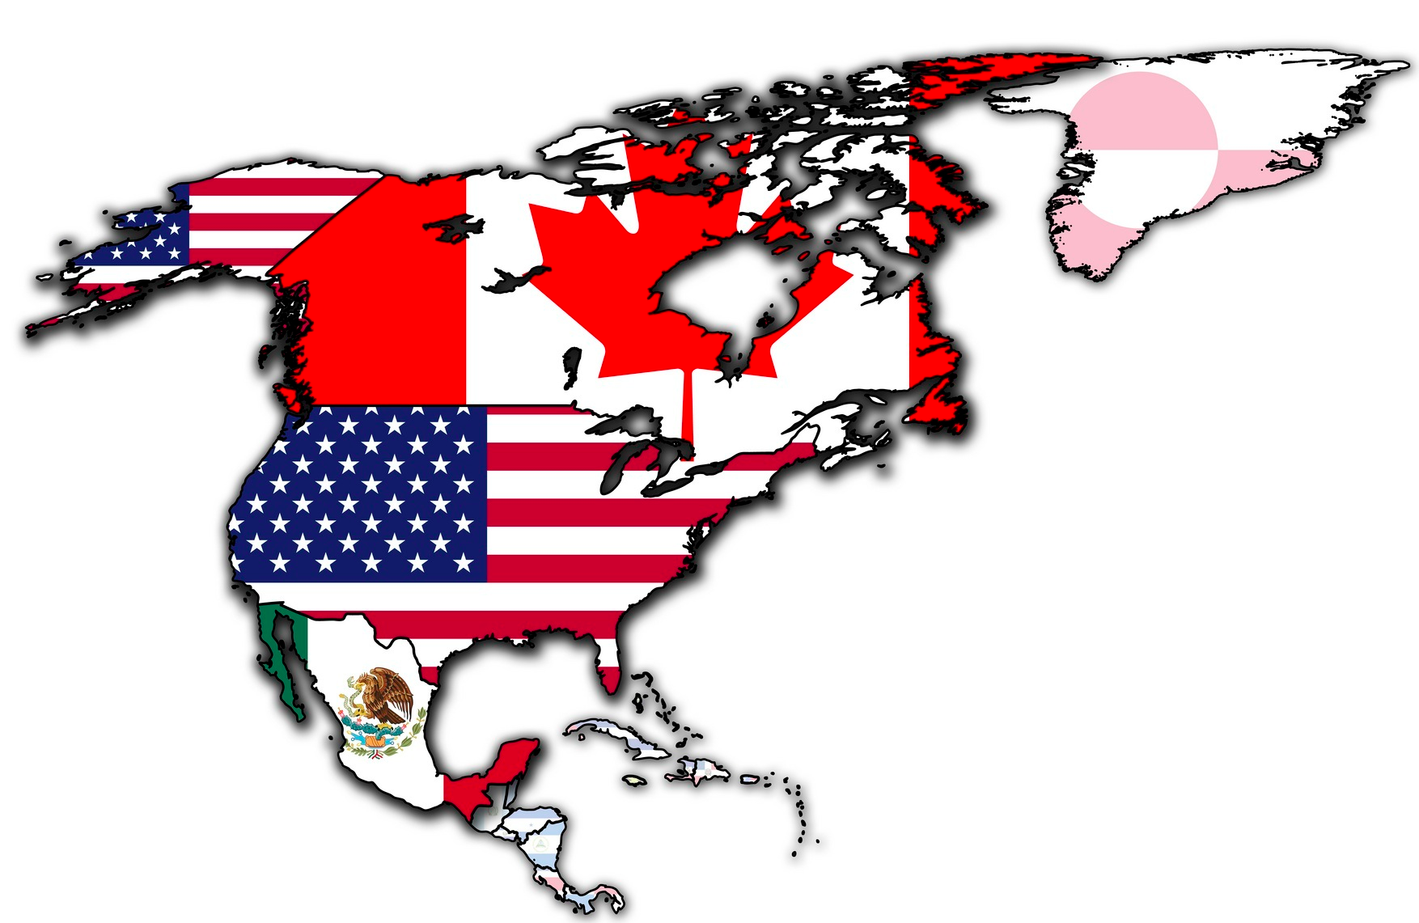
Political Power
Trade organizations
NAFTA North America Free Trade Agreement (1994-2020)
United States, Canada, and Mexico
These countries can trade freely with no tariffs.
Viewed as a threat by labor unions in the U.S.
USMCA U.S. – Mexico – Canada Agreement (01 Jan. 2020)
United States, Canada, and Mexico
These countries can trade freely with no tariffs.
Better balanced trade benefits among members.

Slide 12
Trade and Currencies

Slide 13
Clear Target
Students will be able to explain the difference between fixed and flexible exchange rates.
students will be able to read and use currency exchange tables.

Slide 14
Different Countries Use Different Currencies

Slide 15
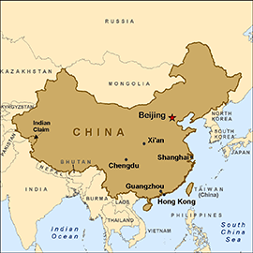
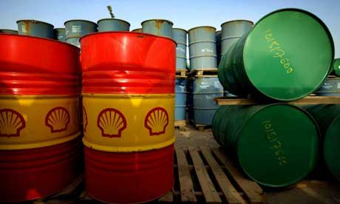
How Do Countries Trade?

Slide 16
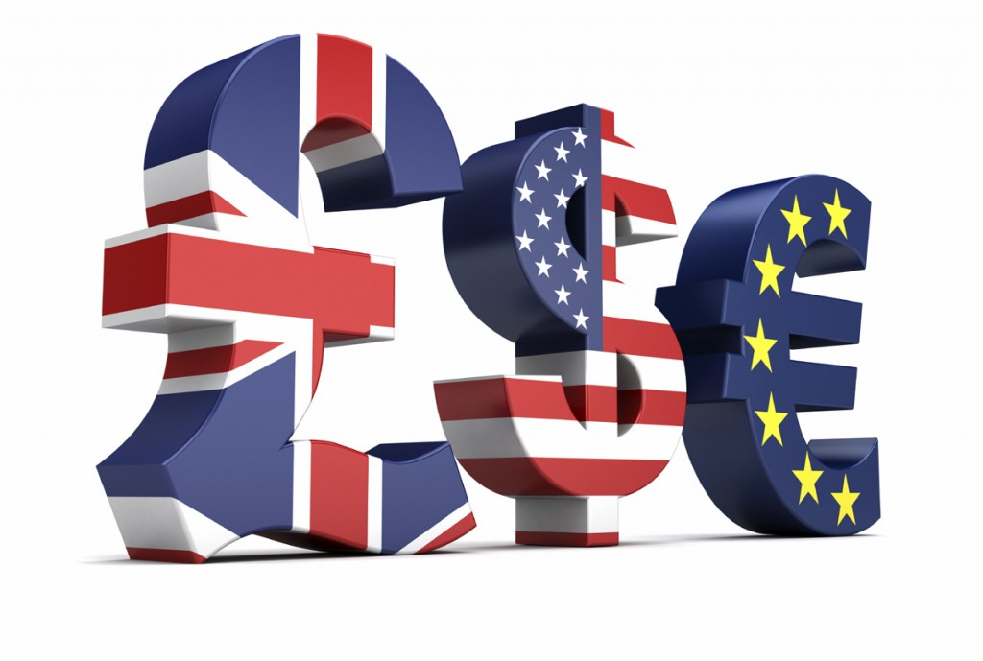
Exchange Rate
The price of nation’s currency in relation to another nation’s currency.

Slide 17
Exchange Rate

Slide 18
Good Afternoon

Slide 19
Clear Target
students will be able to read and use currency exchange tables.

Slide 20
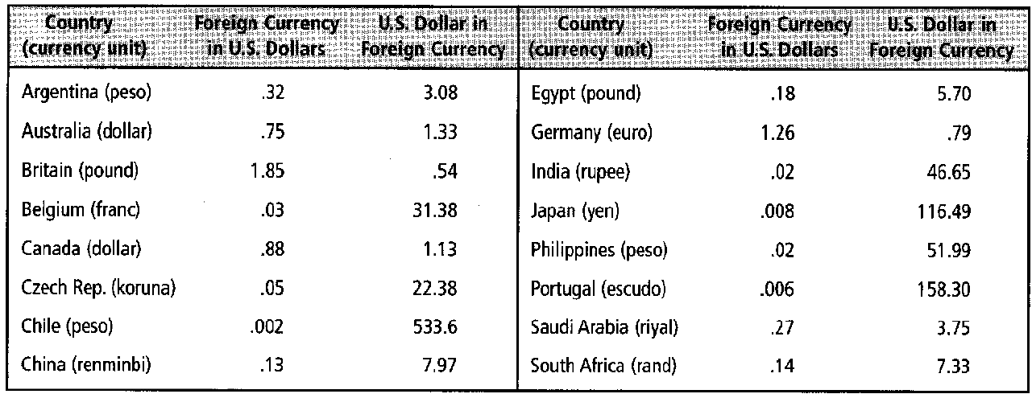

Slide 21
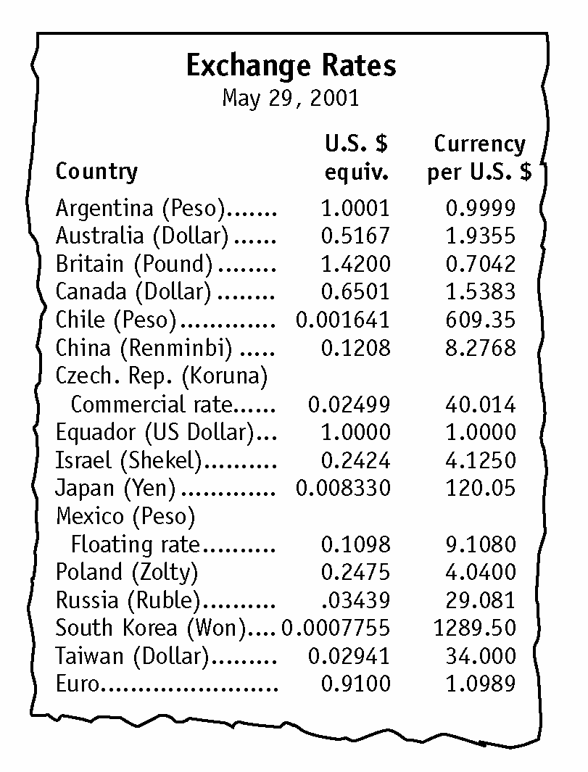

Slide 22
How Are Currencies Valued?
Fixed rate of exchange
Set by government in relation to another nations currency
Devaluation- a government lowering its currencies value in relation to another countries
Flexible exchange rates
Based on supply and demand
The U.S. moved to the flexible exchange rate in 1971
Depreciation- lowering in value of a countries currency because of supply and demand.

Slide 23
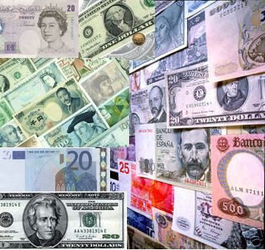
Foreign Exchange Markets
Markets that deal in buying and selling foreign currency for businesses that want to import goods from other countries

